Slide 1
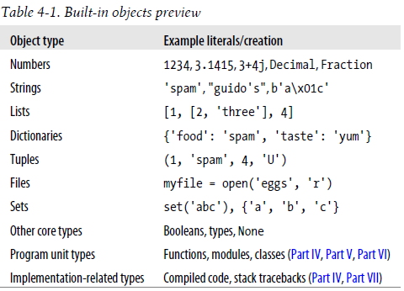
Python Notes with Examples
In python every thing is an object
Built in Object types

Slide 2
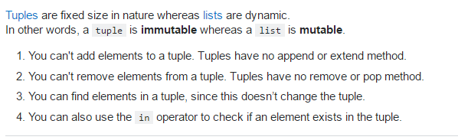
Tuples & Lists comparison

Slide 3
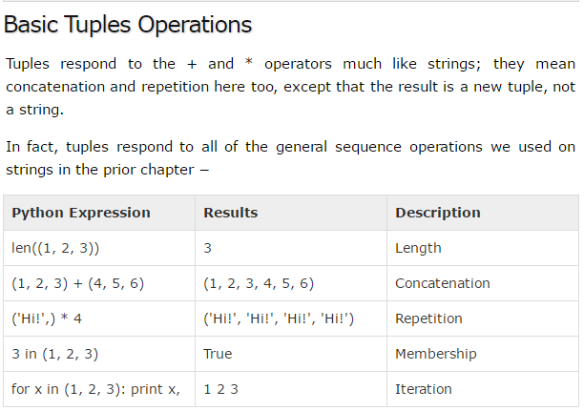
Tuples()

Slide 4
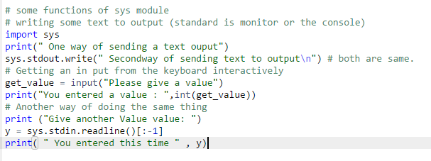
Import sys module

Slide 5
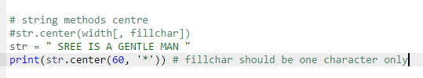

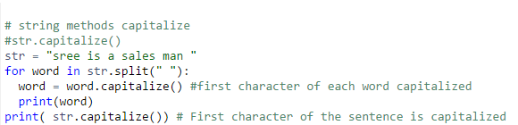
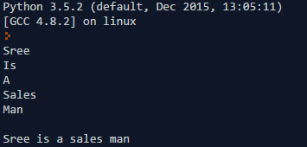
String Methods – str.center(width, [fillchar])
String Methods – str.capitalize()

Slide 6
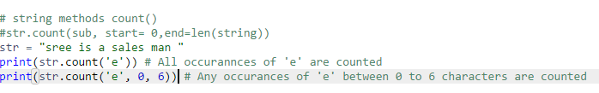

String Methods – str.count()

Slide 7
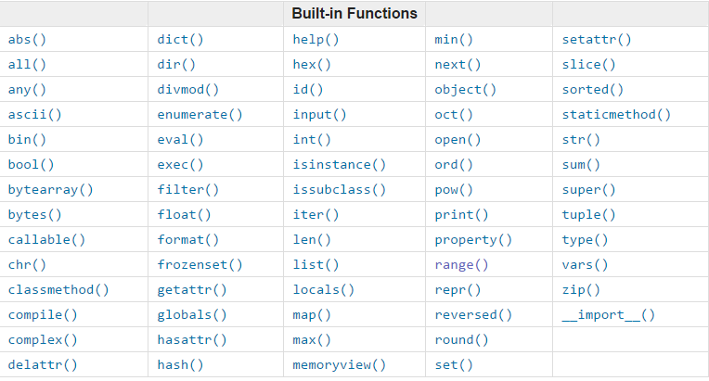
Built-in Python functions

Slide 8
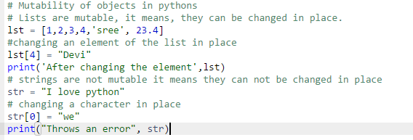
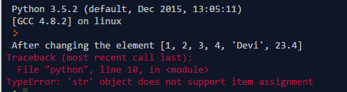
Mutability of Objects

Slide 9
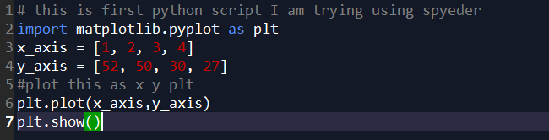
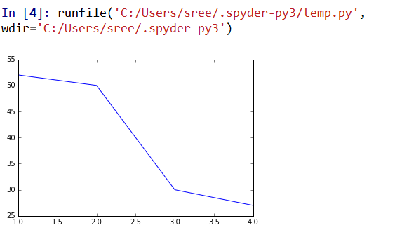
Python plot features

Slide 10
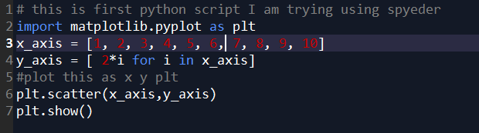
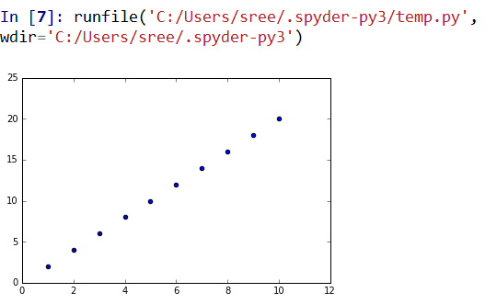
Scatter plot

Slide 11
Numpy python librarya
numpy offers n dimensional arrays.
ndarray is homogenious ( having only same type elements ) array
“Shape” of array – it is a tuple, that shows the size of each element

Slide 12
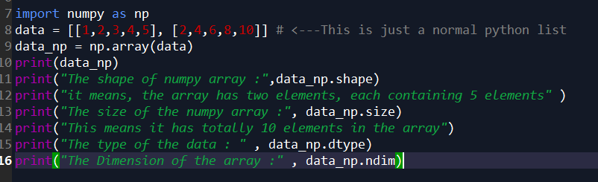
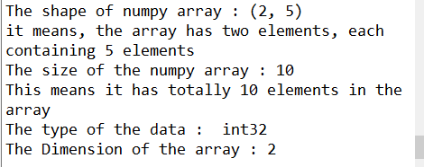
Numpy ndarrays basics

Slide 13
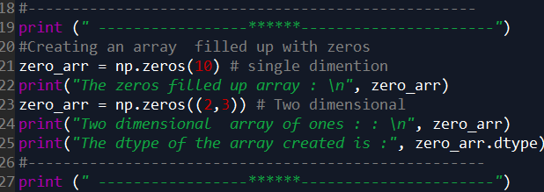
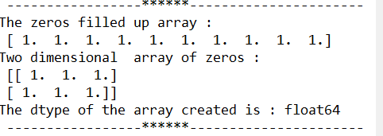
Numpy ndarray basics

Slide 14
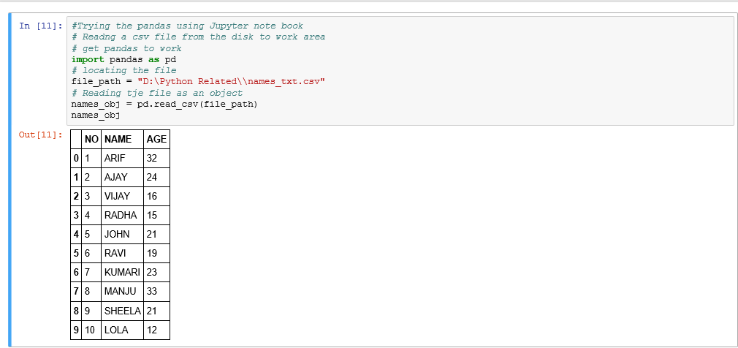
Pandas

Slide 15
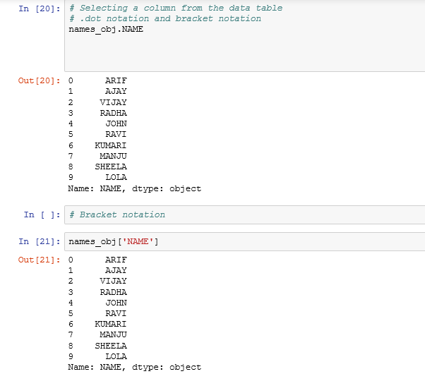
pandas

Slide 16
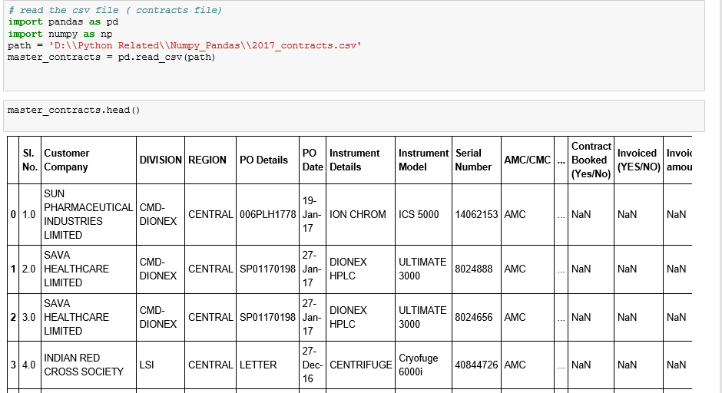
pandas

Slide 17
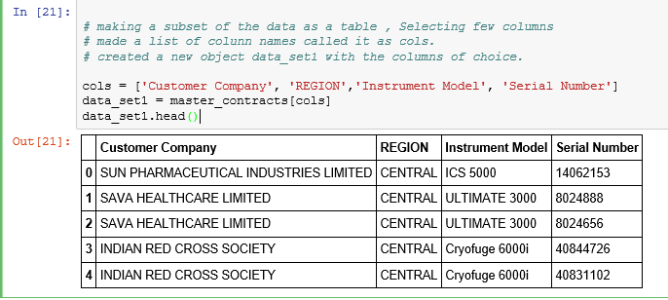
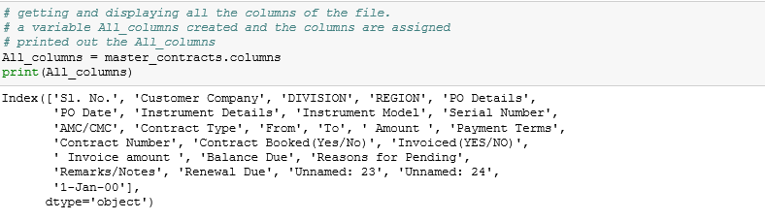
pandas

Slide 18
pandas

Slide 19
pandas

Slide 20
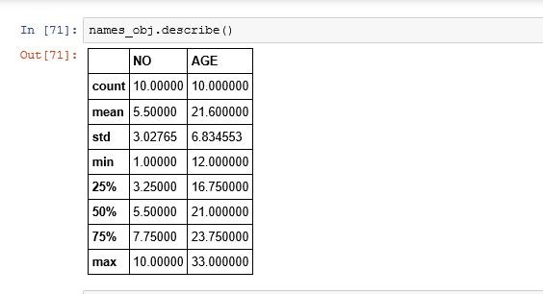
pandas

Slide 21
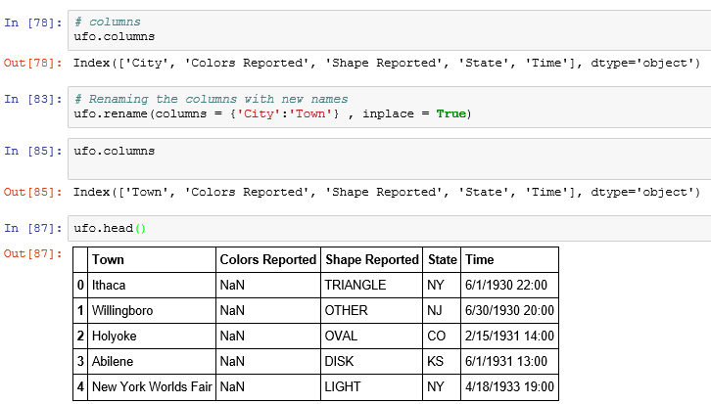
pandas

Slide 22
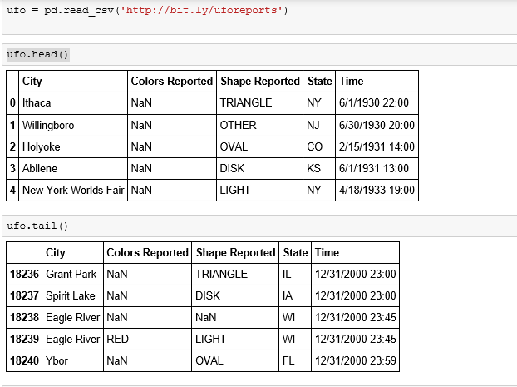
pandas

Slide 23
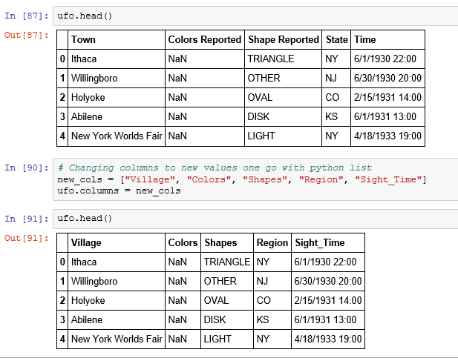
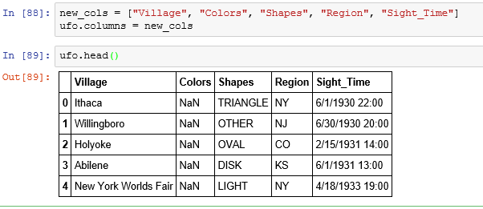
pandas

Slide 24
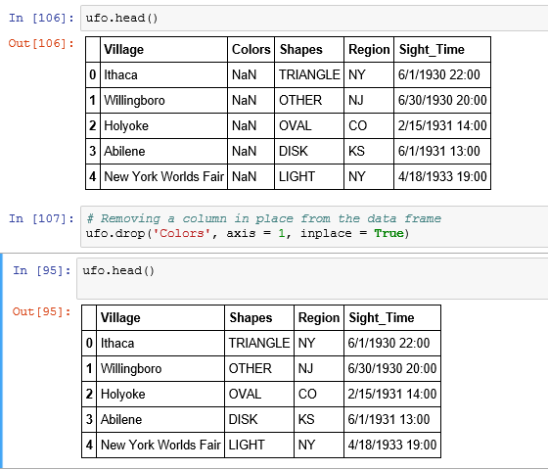
pandas

Slide 26
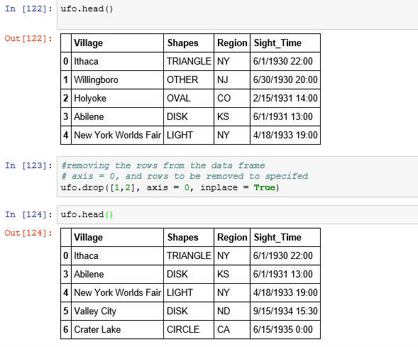
pandas

Slide 27
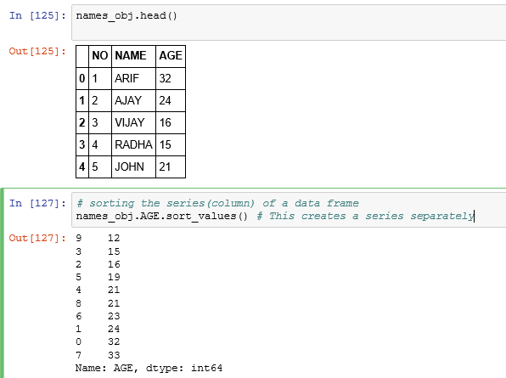
pandas

Slide 28
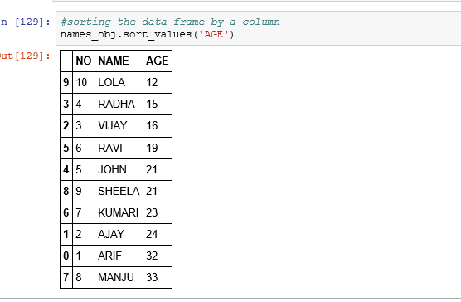

Slide 31
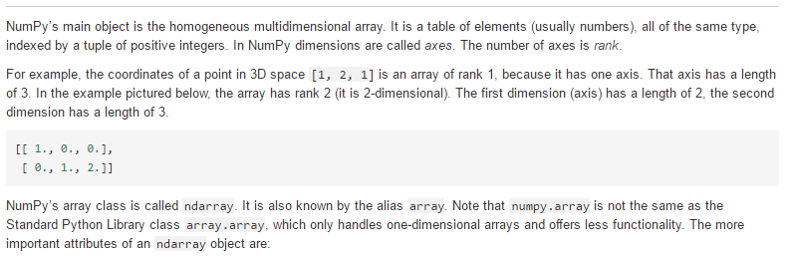
Numpy

Slide 33
Numpy

Slide 34
Numpy

Slide 35
Numpy

Slide 36
Numpy

Slide 37
Numpy

Slide 38
Numpy

Slide 39
Numpy

Slide 40
Numpy

Slide 41
Numpy

Slide 42
Numpy

Slide 43
Numpy

Slide 44
Numpy

Slide 45
Numpy

Slide 46
Numpy

Slide 112
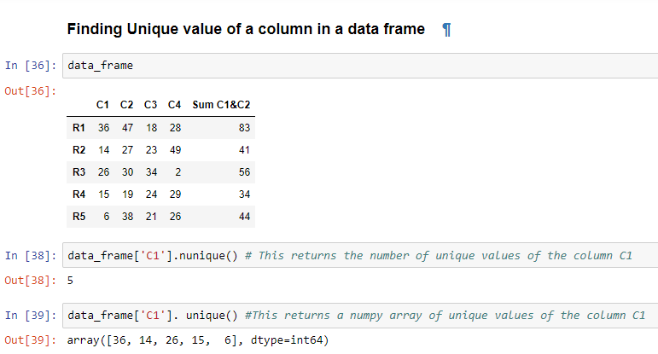
Pandas operations

Slide 113
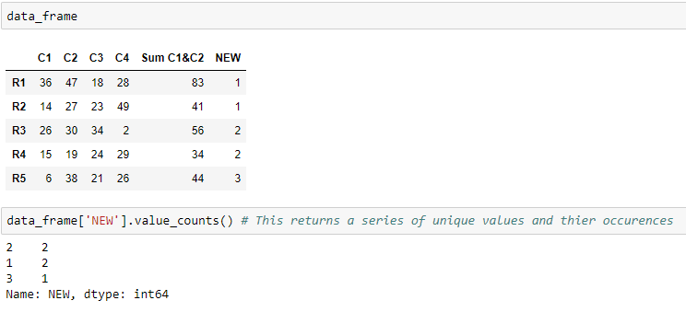
Getting the unique values and their count from a Data Frame column

Slide 114
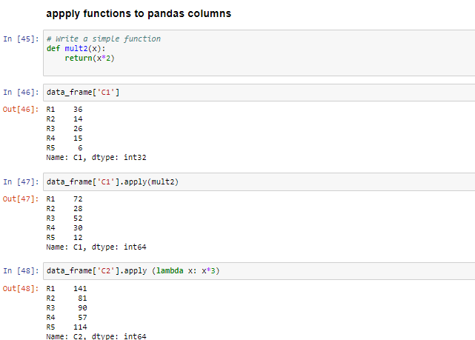
Apply() function

Slide 115
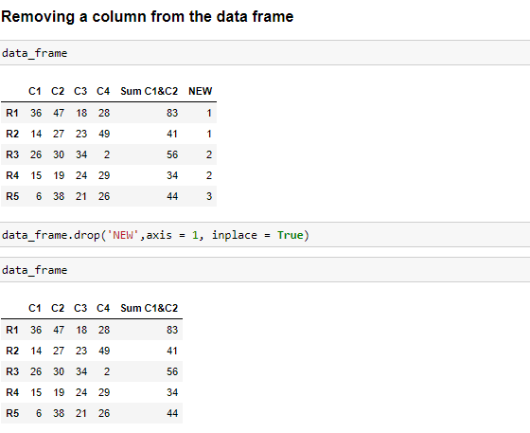
Removing a column from a DataFrame

Slide 116
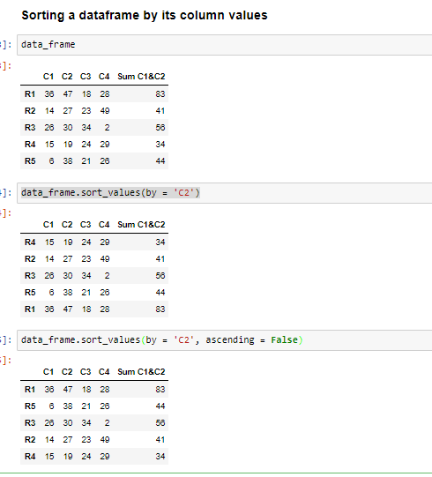
Sorting the DataFrane by its column values

